Slide 2
Two Recent Articles Relevant to Topic
New York Times Article on Tax Rates:
http://www.nytimes.com/2012/03/28/business/economy/the-case-for-raising-top-tax-rates.html
Student Loan Rate Change Article
http://www.alternet.org/education/154251/is_congress_going_to_double_the_interest_on_your_student_loan?page=entire

Slide 3
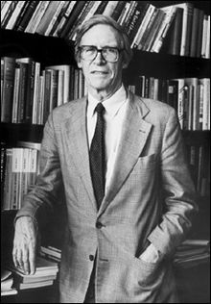
John Rawls (2/21/21 to 11/24/2002)
Photo from Wikipedia entry on Rawls at:
http://en.wikipedia.org/wiki/John_Rawls

Slide 4
Which of these distributions would a utilitarian favor if the bars were measures of happiness?
A
B
C

Slide 5
Which of these distributions would a strict egalitarian favor if the bars measured material resources such as wealth?
A
B
C

Slide 6
Which of these distributions would a Rawls’s difference principle favor if the bars measured material resources such as wealth?
A
B
C

